Slide 1
Technology and THE FUTURE OF RAILROADING
JOHN SCHEIB Chief Legal Officer
EVP Law and Administration
May 17, 2018

Slide 2
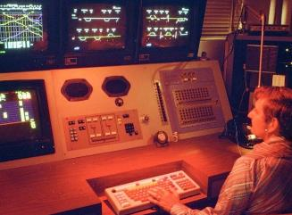
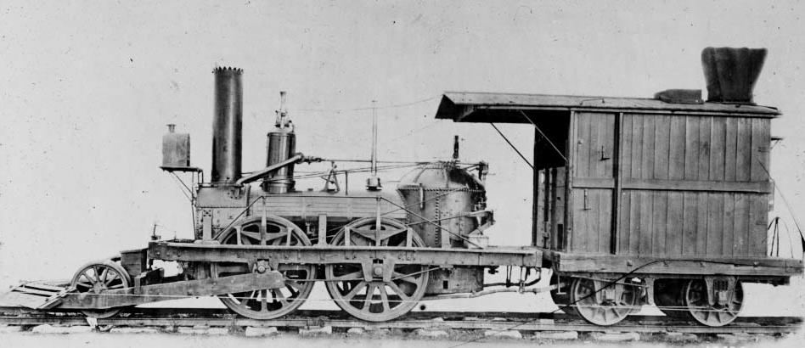
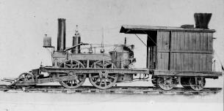
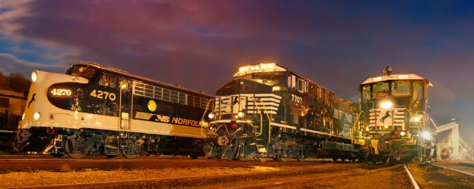
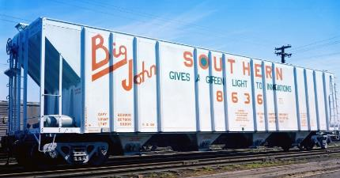
NS and Innovation

Slide 4
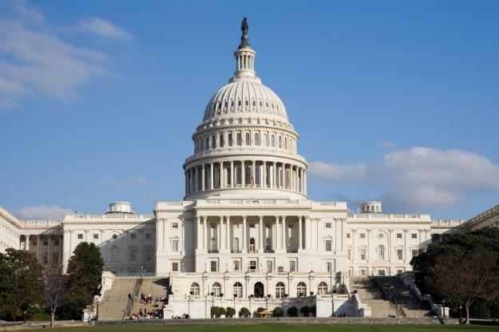
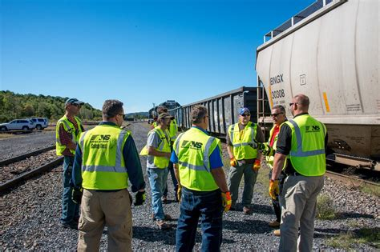

Slide 7
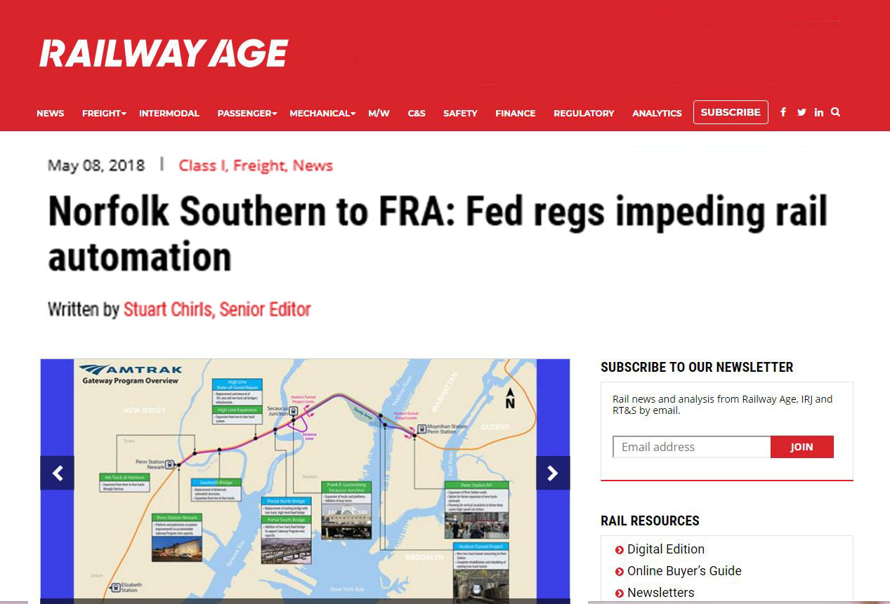

Slide 8
5 SIMPLE POINTS
Technology development is inevitable.
Application of many technologies is easier for rail than other modes.
Safety and productivity are key goals.
PTC is the backbone for many technology-assisted rail operations.
FRA is lagging other agencies in talking about technology and the future.

Slide 10
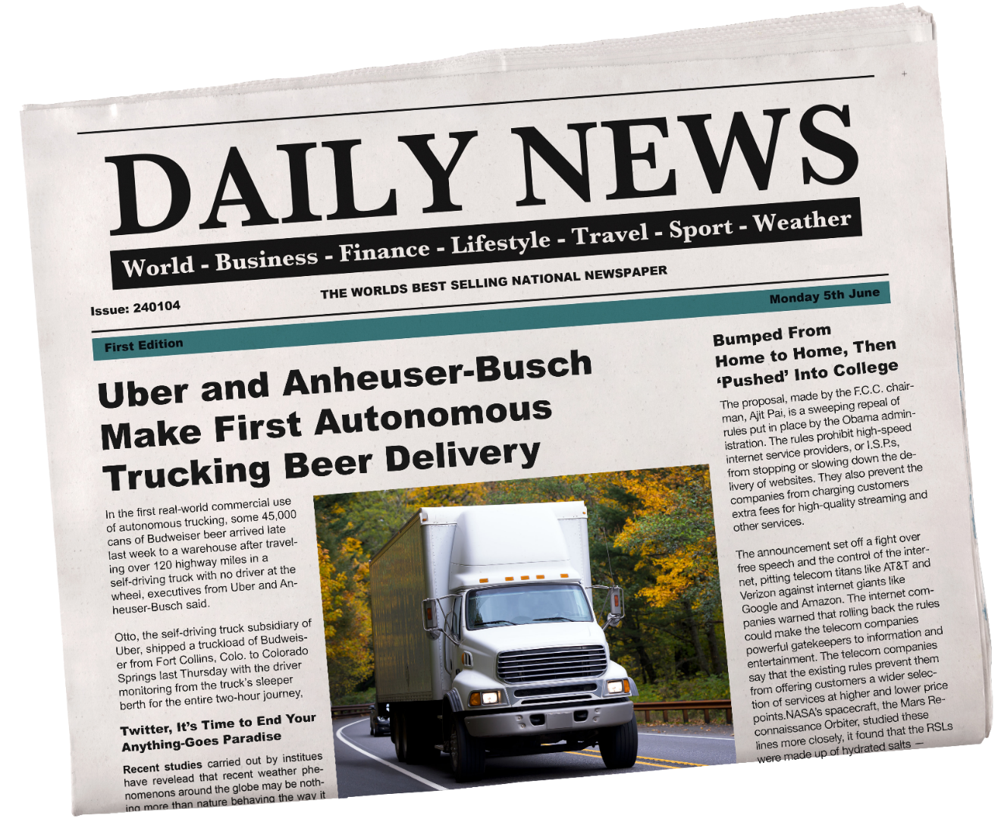

Slide 11
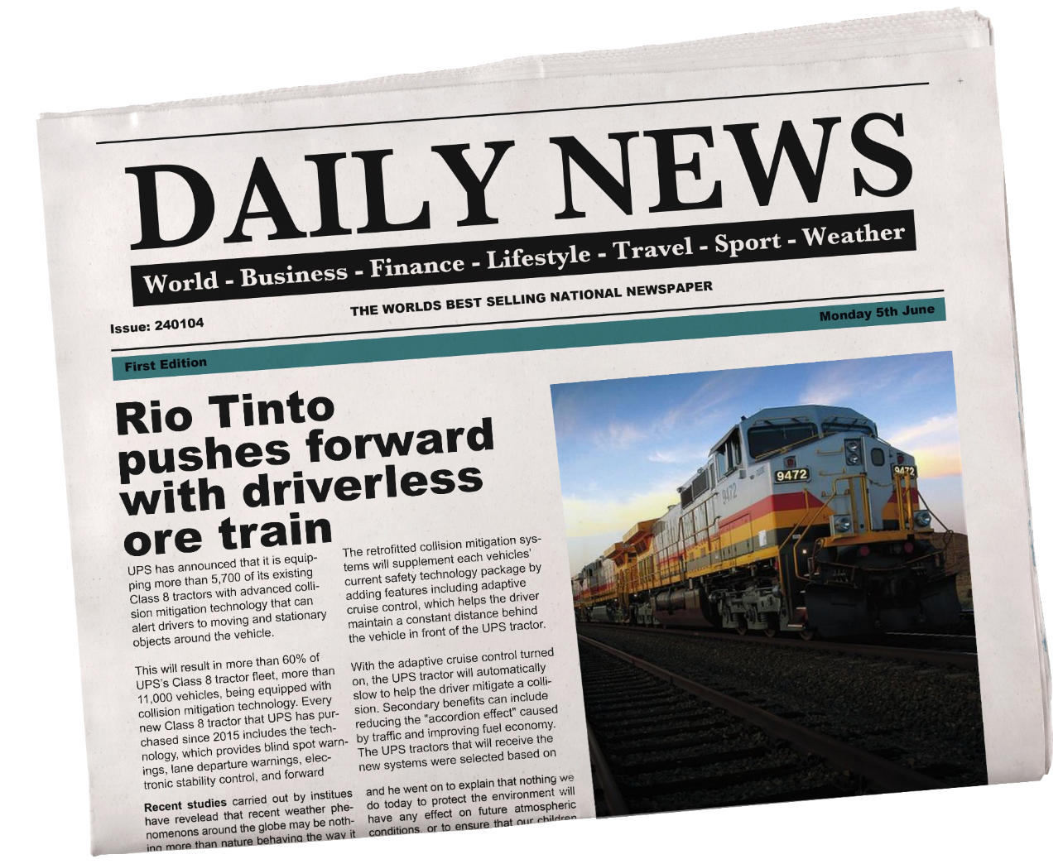

Slide 12
5 SIMPLE POINTS
Technology development is inevitable.
Application of many technologies is easier for rail than other modes.
Safety and productivity are key goals.
PTC is the backbone for many technology-assisted rail operations.
FRA is lagging other agencies in talking about technology and the future.

Slide 13
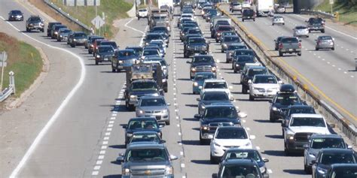
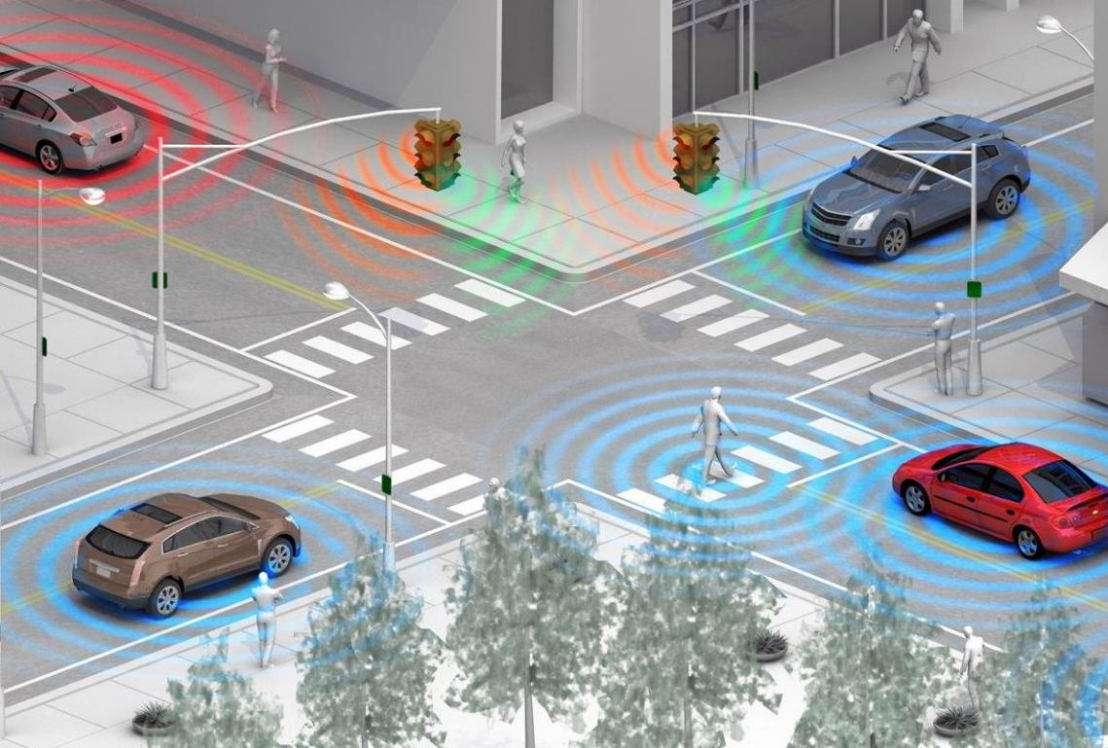

Slide 15
5 SIMPLE POINTS
Technology development is inevitable.
Application of many technologies is easier for rail than other modes.
Safety and productivity are key goals.
PTC is the backbone for many technology-assisted rail operations.
FRA is lagging other agencies in talking about technology and the future.

Slide 16
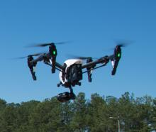
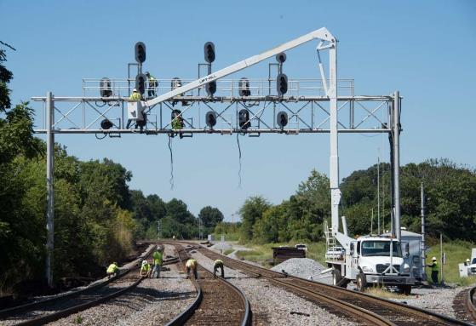
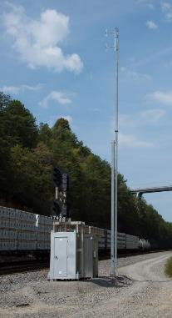
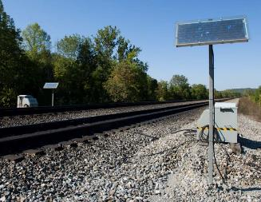
Technology Enhancing Safety

Slide 17
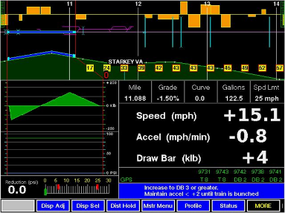
Technology Driving PRODUCTIVITY

Slide 18
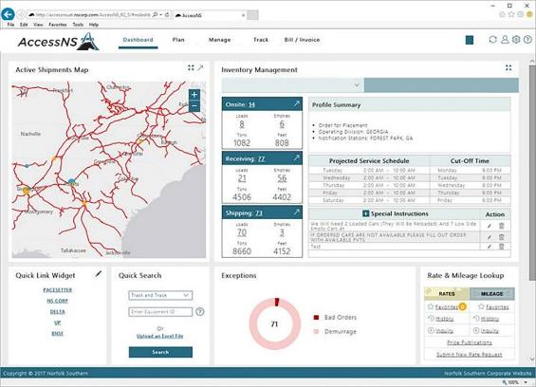
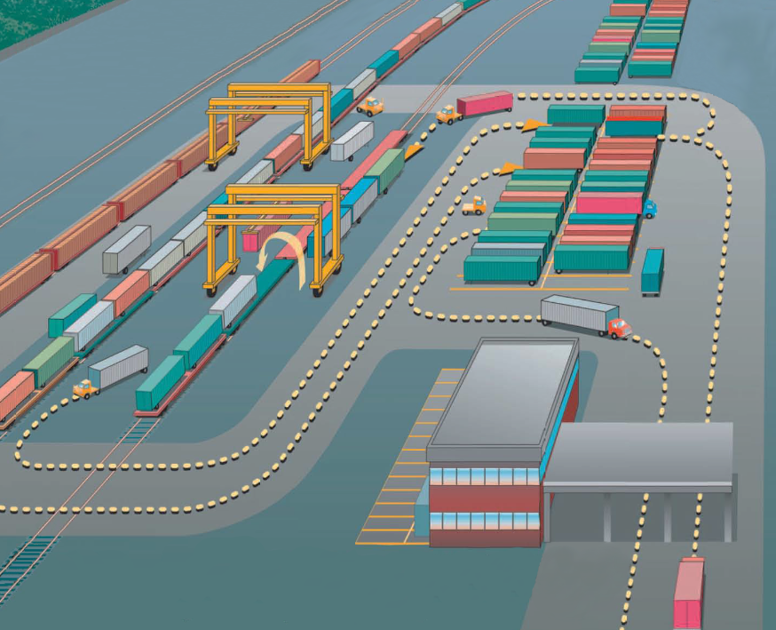
Technology Driving PRODUCTIVITY
Core OPTCS
Yard Management
Load Plan
ExpressNS

Slide 19
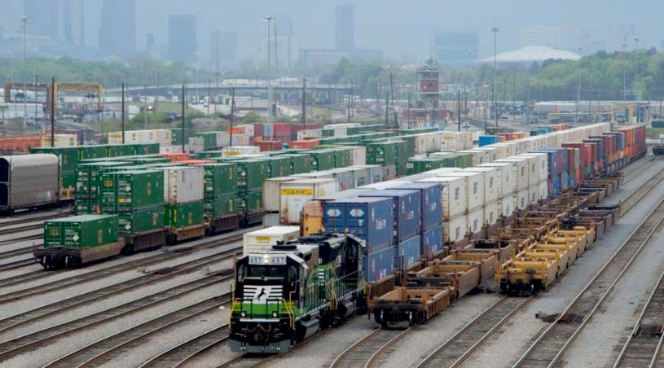
Technology creating growth opportunities

Slide 20
5 SIMPLE POINTS
Technology development is inevitable.
Application of many technologies is easier for rail than other modes.
Safety and productivity are key goals.
PTC is the backbone for many technology-assisted rail operations.
FRA is lagging other agencies in talking about technology and the future.

Slide 22
5 SIMPLE POINTS
Technology development is inevitable.
Application of many technologies is easier for rail than other modes.
Safety and productivity are key goals.
PTC is the backbone for many technology-assisted rail operations.
FRA is lagging other agencies in talking about technology and the future.

Slide 23
Safety, Service, and Efficiency…through Autonomy

Slide 26
Thank you
JOHN SCHEIB Chief Legal Officer
EVP Law and Administration
May 17, 2018

